Slide 1
Algorithms
Lecture 2.2
Dr. Md Moniruzzaman

Slide 2
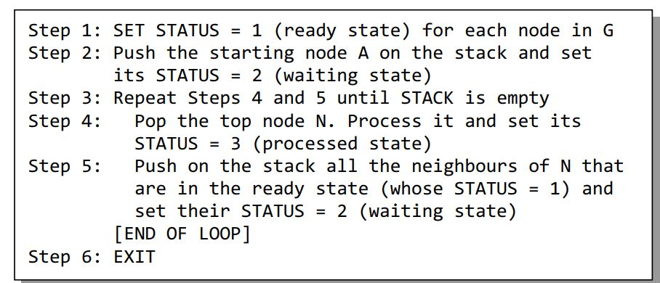
DFS (Continue…)

Slide 3
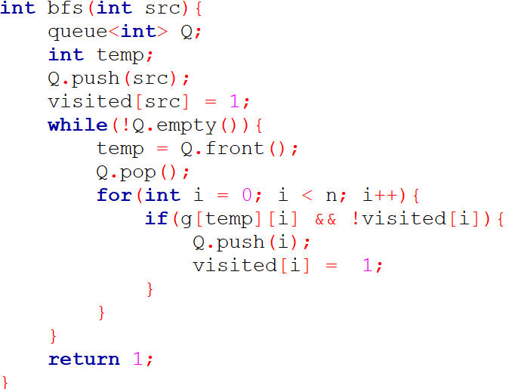
Sample Implementation (Adjacency Matrix)

Slide 4
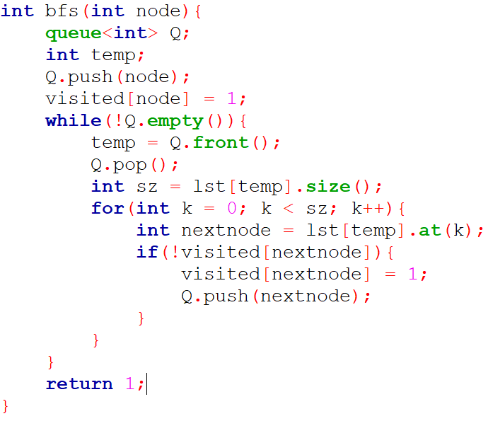
Sample Implementation (Adjacency List)

Slide 5
Problem
Equalizing Money (Lightoj)
https://lightoj.com/problem/equalizing-money
Building Roads (CSES)
https://cses.fi/problemset/task/1666/

